Slide 1


TACTICAL COMBAT CASUALTY CARE COURSE
MODULE 16: ANTIBIOTIC ADMINISTRATION
Module 16: Antibiotic Administration
TCCC TIER 1
All Service Members
TCCC TIER 2
Combat Lifesaver
TCCC TIER 3
Combat Medic/Corpsman
TCCC TIER 4
Combat Paramedic/Provider

Slide 2




Module 16: Antibiotic Administration
TACTICAL COMBAT CASUALTY CARE (TCCC) ROLE-BASED TRAINING SPECTRUM
ROLE 1 CARE
NONMEDICAL PERSONNEL
MEDICAL PERSONNEL
YOU ARE HERE
STANDARDIZED JOINT CURRICULUM
2

Slide 3







Module 16: Antibiotic Administration
1 x TERMINAL LEARNING OBJECTIVES
19
Given a combat or noncombat scenario, perform antibiotic administration during Tactical Field Care in accordance with CoTCCC Guidelines.
  Identify the evidence and considerations for early antibiotic administration in Tactical Field Care.
  Identify the indications, contraindications, and administration methods of antibiotics in Tactical Field
  Care.
Describe the indications, contraindications, dosage, route, and administration methods of moxifloxacin in
  Tactical Field Care.
Describe the indications, contraindications, dosage, route, and administration methods of ertapenem in
  Tactical Field Care.
Demonstrate the preparation and administration of CoTCCC-recommended antibiotics in Tactical Field Care.
05 x ENABLING LEARNING OBJECTIVES
#
= Terminal Learning Objectives
= Cognitive ELOs
= Performance ELOs
33

Slide 4


MARCH PAWS
Module 16: Antibiotic Administration
LIFE-THREATENING
_{M} MASSIVE BLEEDING
#1 Priority
_{A} AIRWAY
_{R} RESPIRATION (Breathing)
_{C} CIRCULATION
_{H} HYPOTHERMIA / HEAD INJURIES
AFTER LIFE-THREATENING
P
PAIN
A
ANTIBIOTICS
W S
WOUNDS
SPLINTING
4

Slide 5
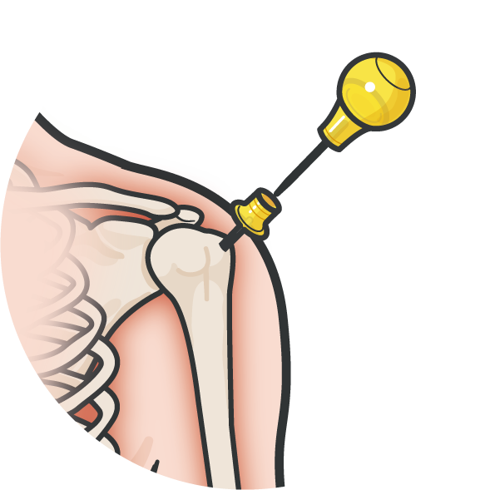
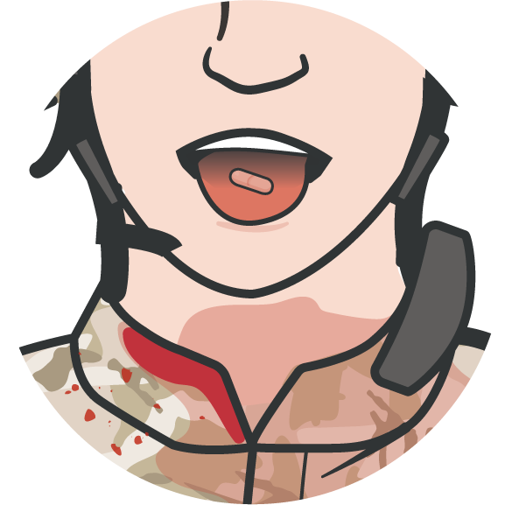

Module 16: Antibiotic Administration
THE IMPORTANCE OF EARLY ANTIBIOTIC ADMINISTRATION
1944
WWII
Penicillin administered at front line surgical units saved lives
1950/
60s
Korea & Vietnam
Recommended battlefield antibiotics for any delays in evacuation to hospitals
1993
Battle of Mogadishu (1993)
16/58 casualties’ wounds infected with 15-hour delay to treatment
Antibiotics must be given as soon as possible after injury to maximize their ability to prevent wound infections
1996
Initial TCCC Guidelines recommend battlefield antibiotics
2003
Battle of Iraq – road to Baghdad (2003)
32 casualties treated in battlefield had negligible infections despite 11-hour evac delay
2007 review of TCCC noted no reports of adverse effects from the use of battlefield antibiotics during GWOT operations
P
A
W S
55

Slide 6
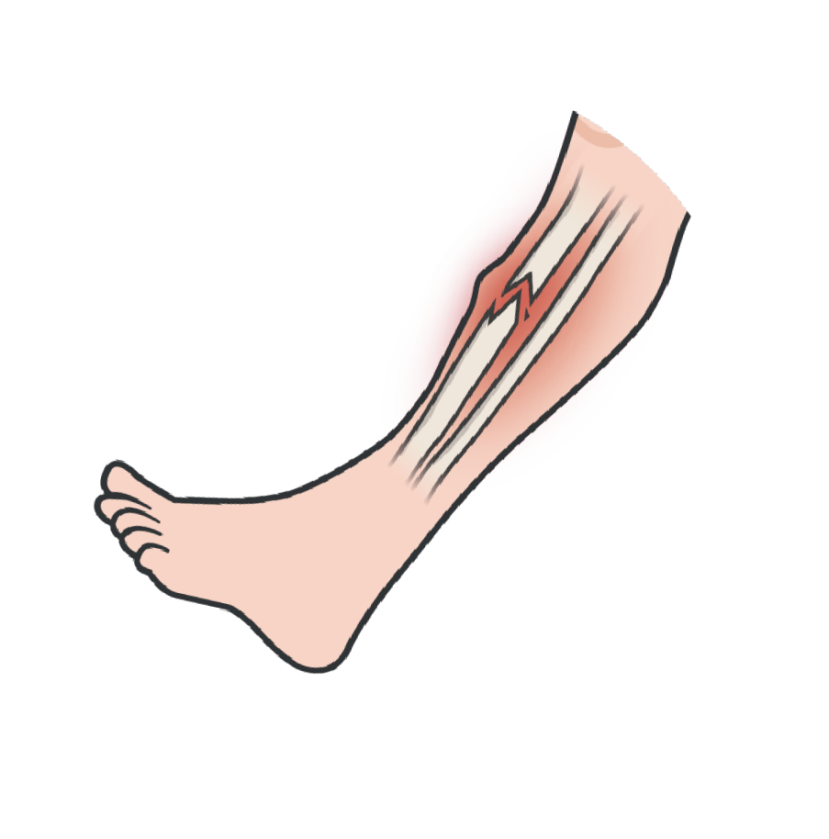
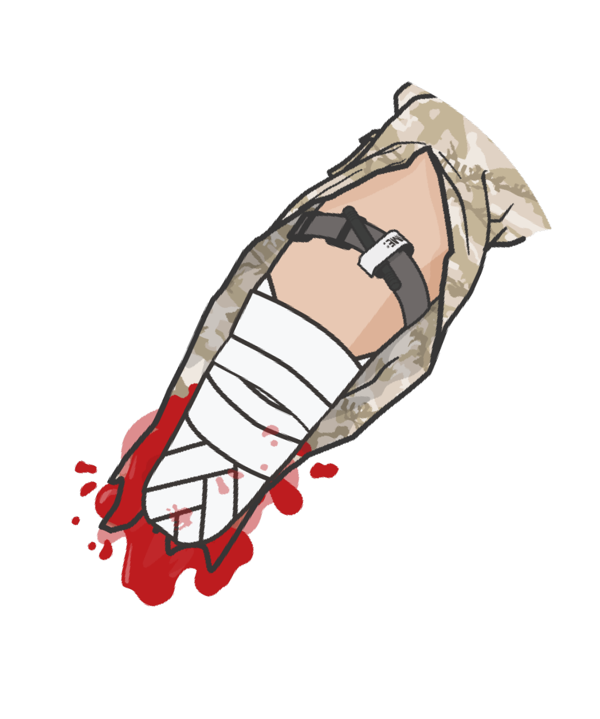
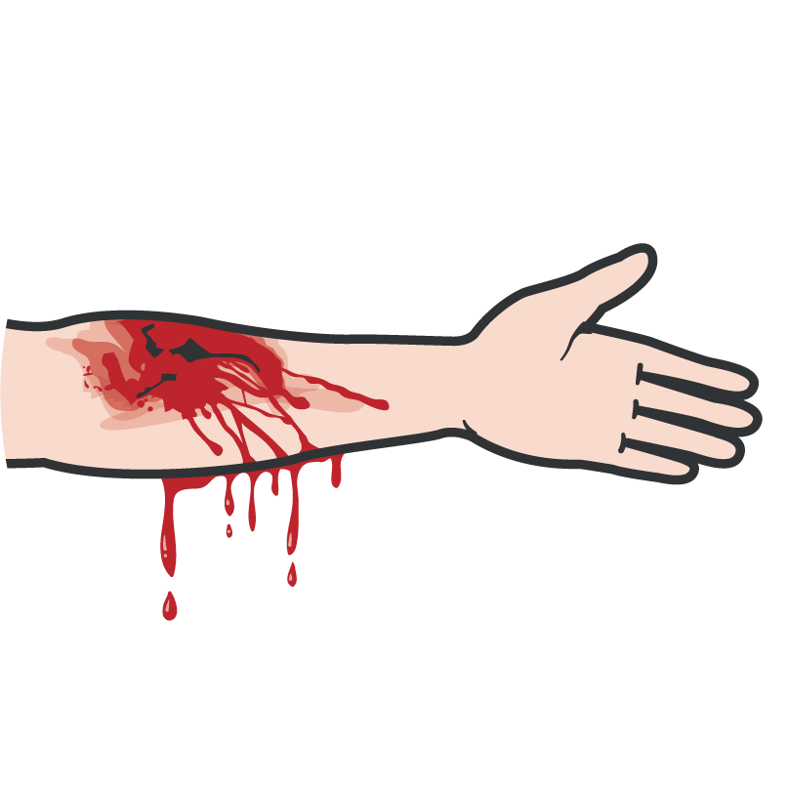
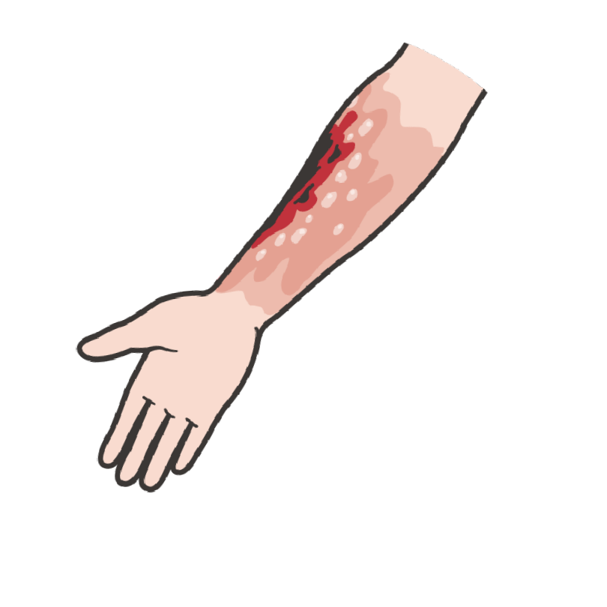
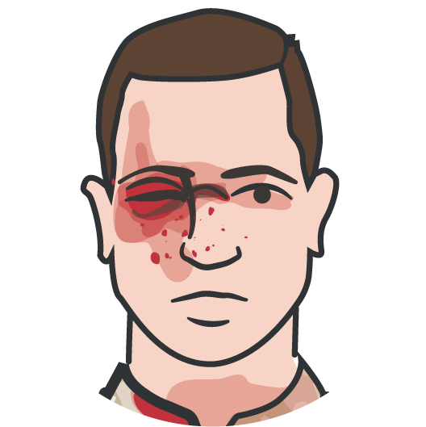
Module 16: Antibiotic Administration
INDICATIONS AND CONTRAINDICATIONS TO ANTIBIOTICS IN TFC
Antibiotics are indicated in all with open combat wounds, regardless of the mechanism of injury
Choosing the best antibiotics
Effectiveness across a broad range of pathogens
Minimal side effects Environmental stability
Simple and infrequent dosage regimens
Comparatively low cost
Open Fractures
Burns (with penetrating trauma)
Amputations
Eye Injuries
Bleeding
Very good safety profile of oral and parenteral antibiotics on the battlefield
Only contraindication is a known drug allergy
Oral - Moxifloxacin
Parenteral - Ertapenem
P
A
W S
6

Slide 7
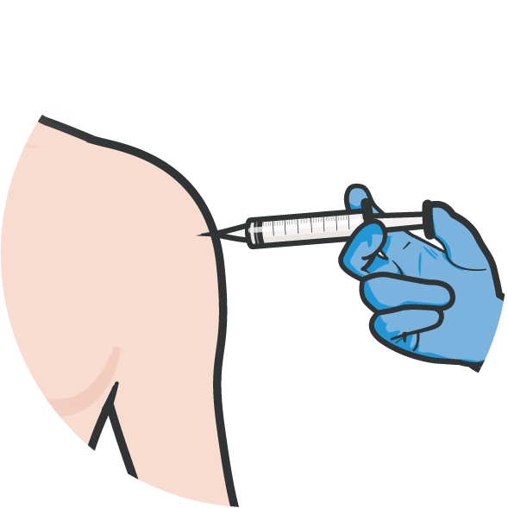
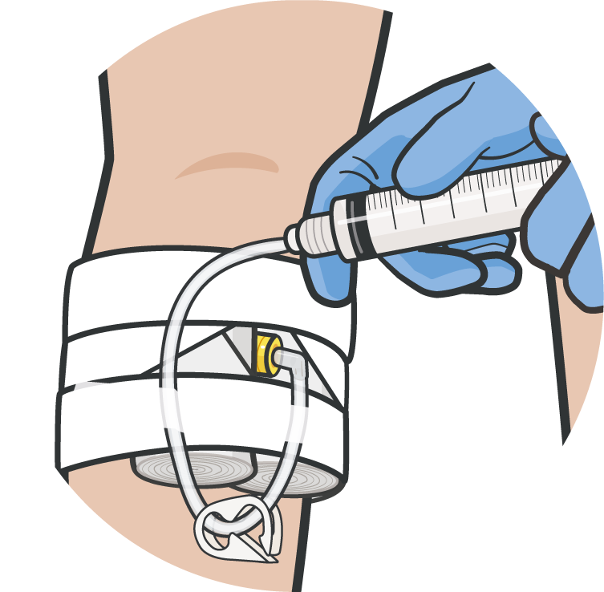
Module 16: Antibiotic Administration
METHODS OF ADMINISTRATION OF ANTIBIOTICS IN TFC
The two methods of administering antibiotics in the tactical setting:
Oral route preferred because
Fewer supplies to carry No reconstitution needed
Saves resources and time spent injecting or infusing parenteral medications
By mouth
By parenteral injection
(intramuscular, intravenous or intraosseous)
Parenteral administration required if: Unconscious
Cannot swallow In shock
P
A
W S
77

Slide 8

ANTIBIOTIC ADMINISTRATION OVERVIEW
8

Slide 9
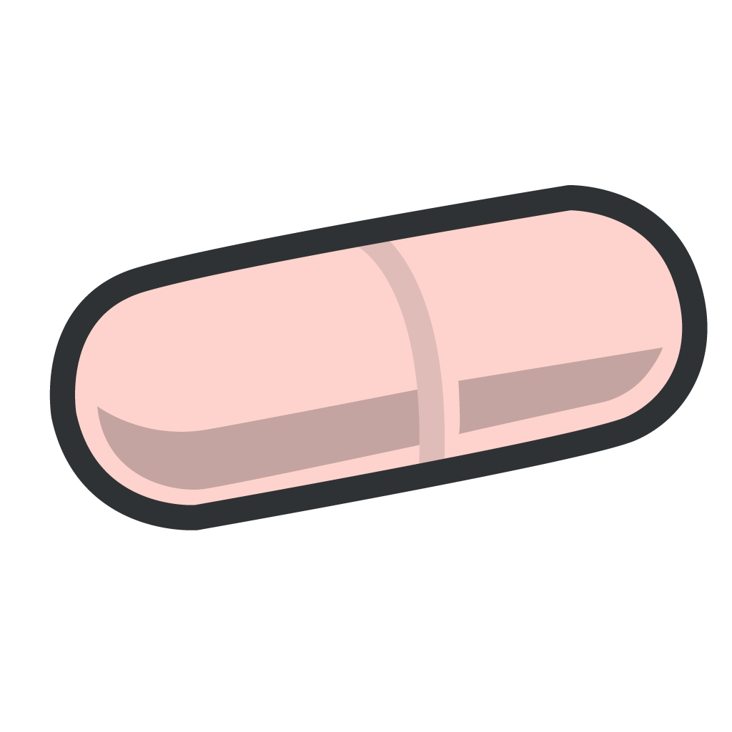

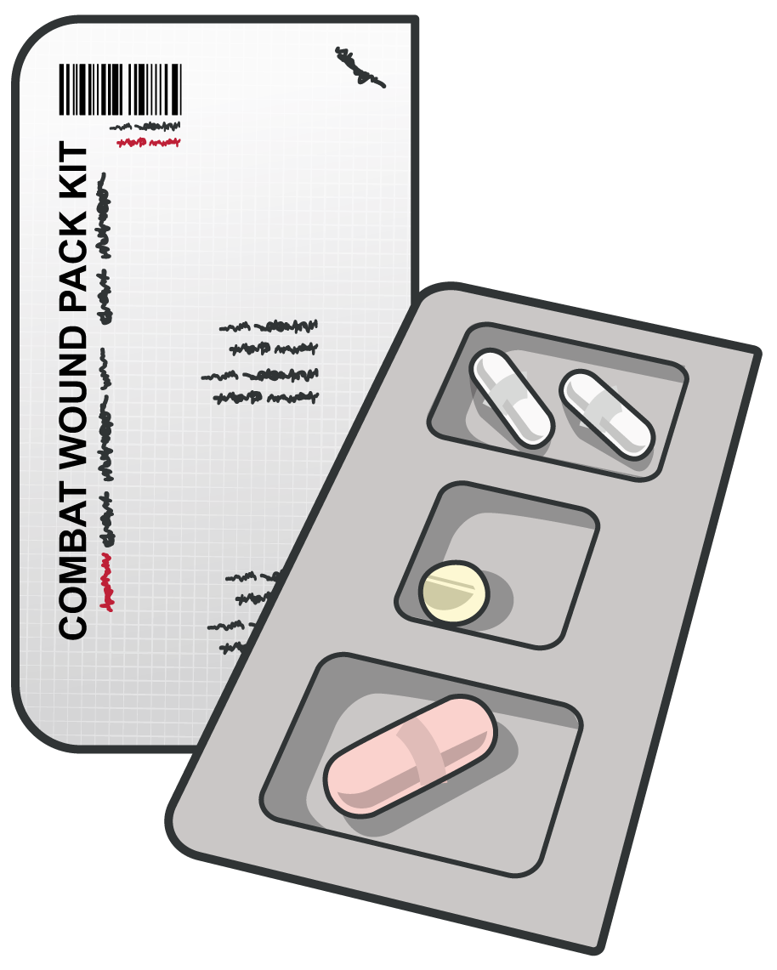
Module 16: Antibiotic Administration
MOXIFLOXACIN ADMINISTRATION
DOSAGE(S):
Document time of administration on casualty
DD Form 1380
POTENTIAL SIDE EFFECTS:
400 mg 1 daily
Dizziness, headache, peripheral neuropathy, nausea, diarrhea, abdominal pain, vomiting, taste perversion, abnormal LFTs, dyspepsia, and tendon rupture
ROUTE(S):
Moxifloxacin is available in PO form
INDICATIONS:
Recommended for all open combat wounds if able to take PO meds
Standard moxifloxacin dose is in the Combat Wound Medication Pack (CWMP)
CONTRAINDICATIONS:
Fluoroquinolone allergy
P
A
W S
99

Slide 10
Module 16: Antibiotic Administration
MOXIFLOXACIN ADMINISTRATION (Cont.)
DRUG INTERACTIONS:
Iron, zinc, antacids, aluminum, magnesium, calcium, and sucralfate decrease absorption, atenolol, cisapride, erythromycin, antipsychotics, TCAs, quinidine, procainamide, amiodarone, sotalol may prolong QTc interval, may cause false positive on opiate screening tests
TACTICAL CONSIDERATIONS:
Use the moxifloxacin from the casualty’s own Combat Wound Medication Pack
Minimal to no mission impact
ADVANTAGES:
Excellent intraocular penetration when taken systemically
Effective for most gram-positive and gram-negative bacteria; ideal for treatment of eye injuries
ONSET/PEAK/DURATION:
1 hr/2 hr/20-24 hr
Know unit members’ allergies prior to deployment and determine alternate antibiotics with medical officer, as needed
P
A
W S
1100

Slide 11
Module 16: Antibiotic Administration
ERTAPENEM ADMINISTRATION
DOSAGE(S):
Document time
of administration on casualty
DD Form 1380
POTENTIAL SIDE EFFECTS:
Injection site phlebitis or thrombosis, asthenia, fatigue, death, fever, leg pain, anxiety, altered mental status, dizziness, headache, insomnia, chest pain, hypo- or hypertension, tachycardia, edema, abdominal pain, diarrhea, acid reflux, constipation, dyspepsia, nausea, vomiting, increased LFTs, cough, dyspnea, pharyngitis, rales, rhonchi, respiratory distress, erythema, pruritus, and rash.
1g every 24 hours
ROUTE(S):
Ertapenem is available in IV, IO, or IM form
INDICATIONS:
Recommended for all open combat wounds if unable to take PO meds
CONTRAINDICATIONS:
Beta-lactam allergy (penicillin, cephalosporins) or lidocaine (for IM injections)
Know unit members’ allergies prior to deployment and determine alternate antibiotics with medical officer, as needed
P
A
W S
1111

Slide 12

Module 16: Antibiotic Administration
ERTAPENEM ADMINISTRATION (Cont.)
DRUG INTERACTIONS:
TACTICAL CONSIDERATIONS:
Probenecid decreases renal excretion
For IV reconstitute with 10 ml NS –
don’t mix with dextrose or infuse with other meds
For IM reconstitute 3.2ml of 1% lidocaine (without epinephrine)
ONSET/PEAK/DURATION:
30 sec-5 min/30 min-2 hr/24hr
ADVANTAGES:
Parenteral antibiotic of choice based on:
Once-a-day dosing
Excellent broad-spectrum coverage Good safety profile
P
A
W S
1122

Slide 13

SKILL STATION
Module 16: Antibiotic Administration
Antibiotic Administration
Demonstrate administration of moxifloxacin and ertapenem

Slide 14
SUMMARY
Module 16: Antibiotic Administration
The importance of early antibiotic administration
General indications and methods of antibiotic administration Indications and considerations for administering moxifloxacin Indications and considerations for administering ertapenem Demonstration of the preparation and administration of antibiotics

Slide 15

CHECK ON LEARNING
Module 16: Antibiotic Administration
What is the oral antibiotic of choice and its dose?
When should you use ertapenem instead of moxifloxacin as an antibiotic therapy?
What are the advantages of using an oral antibiotic over a parenteral antibiotic?
When should you administer antibiotics in the Tactical Field Care phase?

Slide 16



Module 16: Antibiotic Administration
ANY QUESTIONS?

Slide 17

REFERENCES
Module 16: Antibiotic Administration
TCCC: Guidelines
by JTS/CoTCCC
Updated regularly – latest edition dated 5 November 2020
These guidelines are the result of decisions made by the Committee on Tactical Combat Casualty Care as they explore evidence-based research regarding best practices
PHTLS: Military Edition, Chapter 25
by NAEMT
Prehospital Trauma Life Support, Military Ninth Edition
NOV 2020
1177

